Slide 1
The use of large self-organizing maps for mass cytometry data analysis
Tyler J Burns, Ph.D.
Visiting Scholar for Yvan Saeys
VIB Ghent
Computational Biologist, AG Mei
DRFZ Berlin

Slide 2
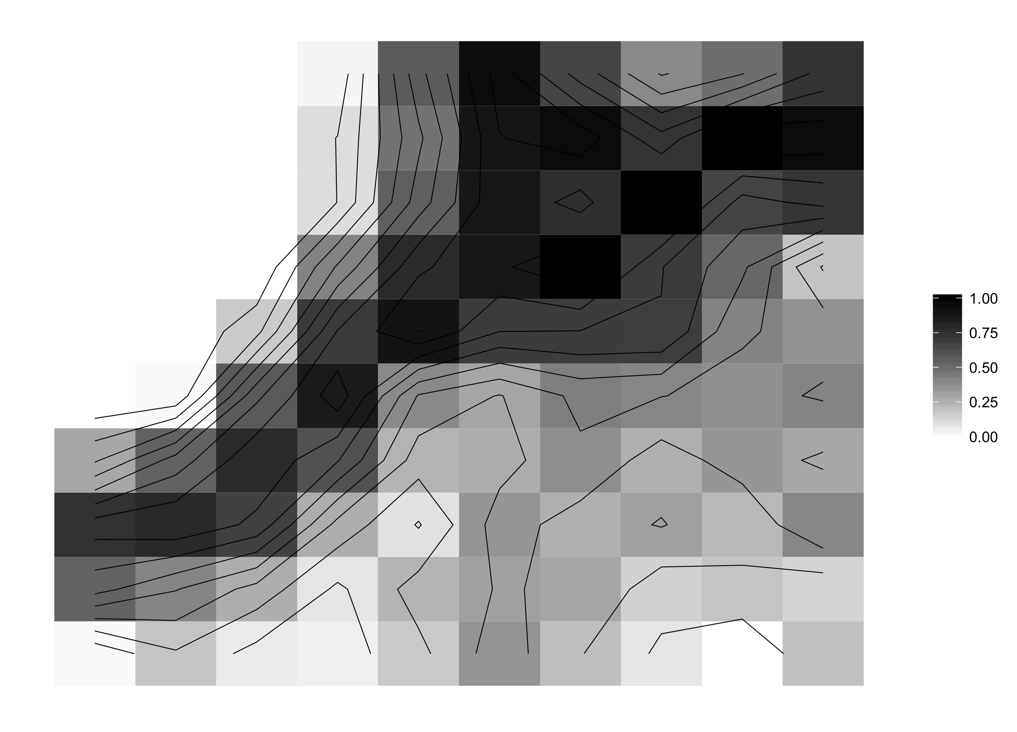
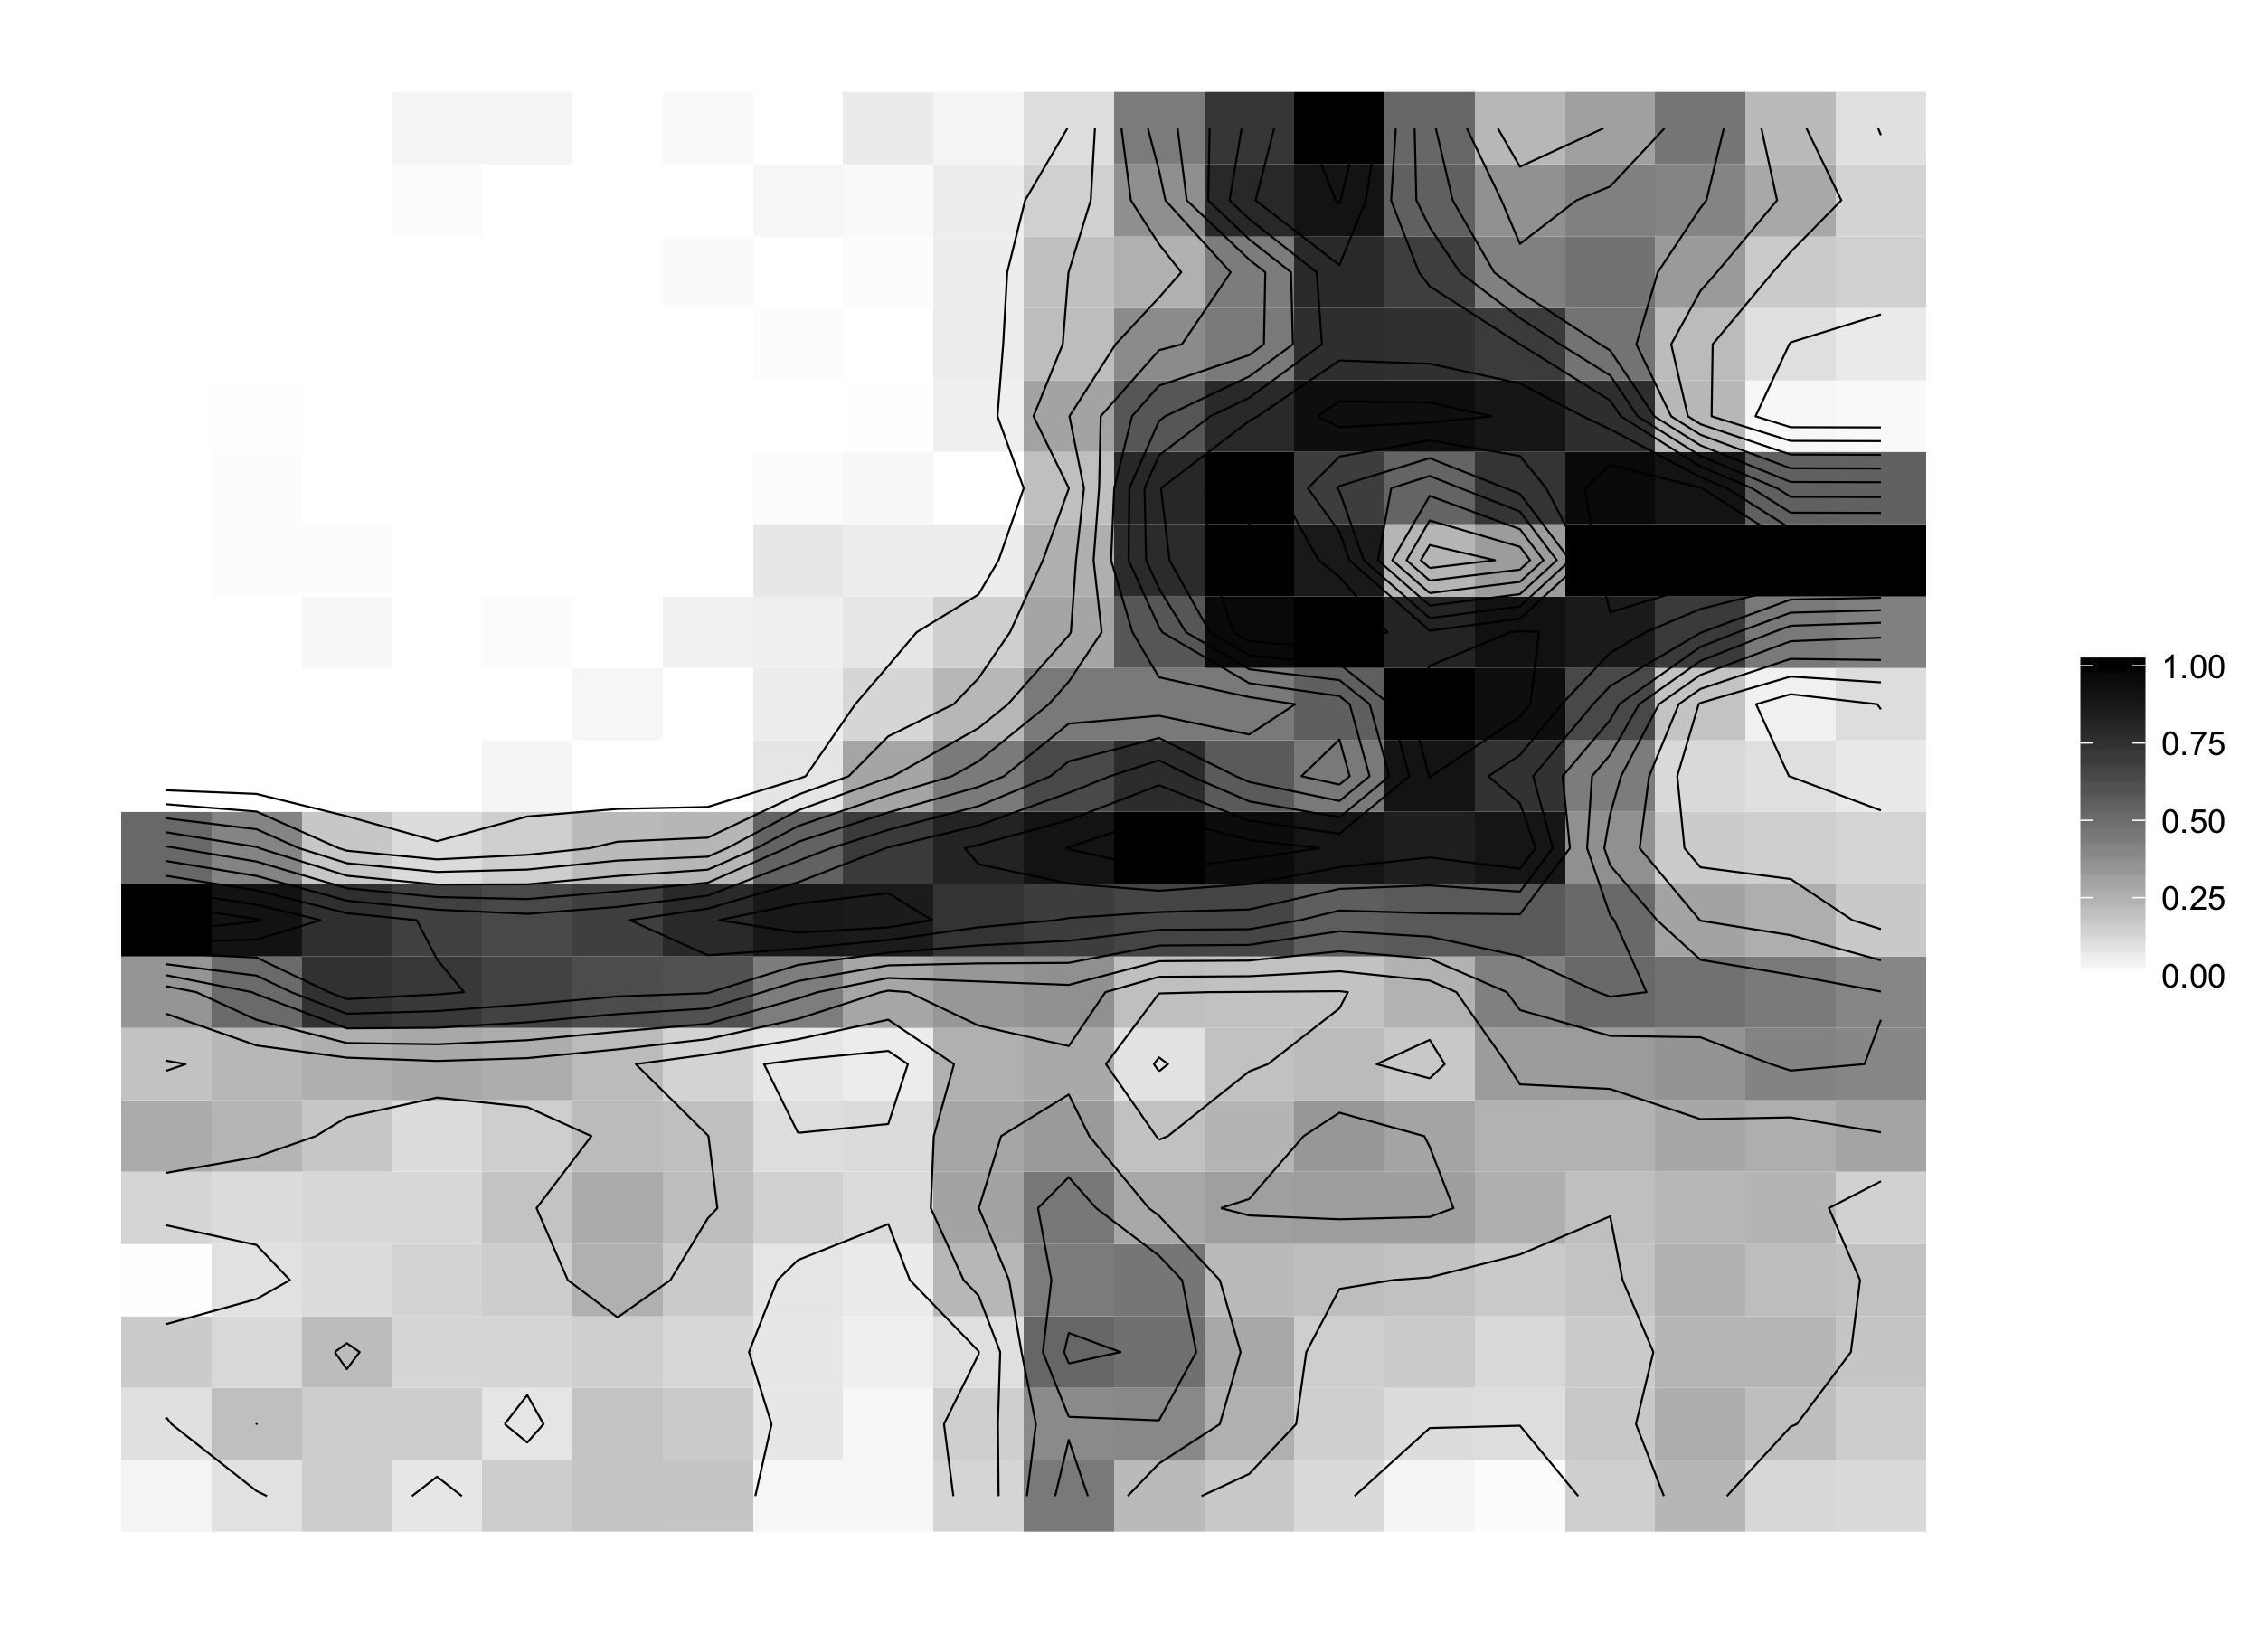
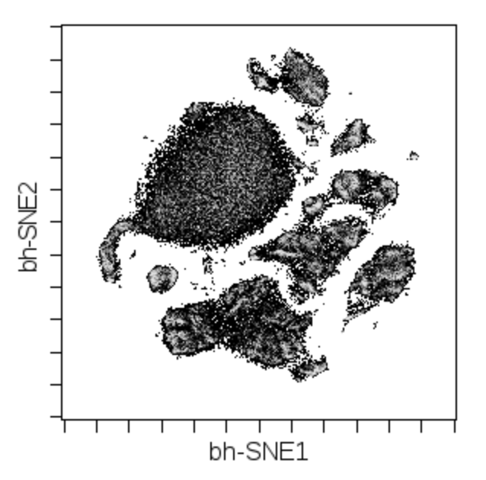
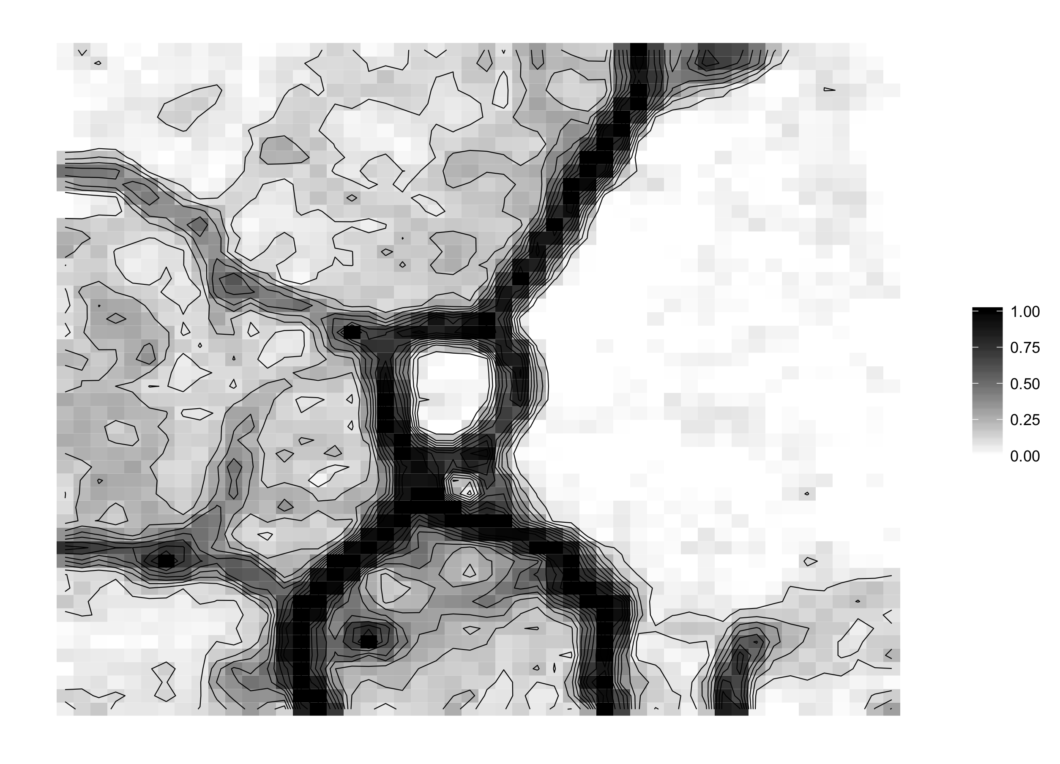
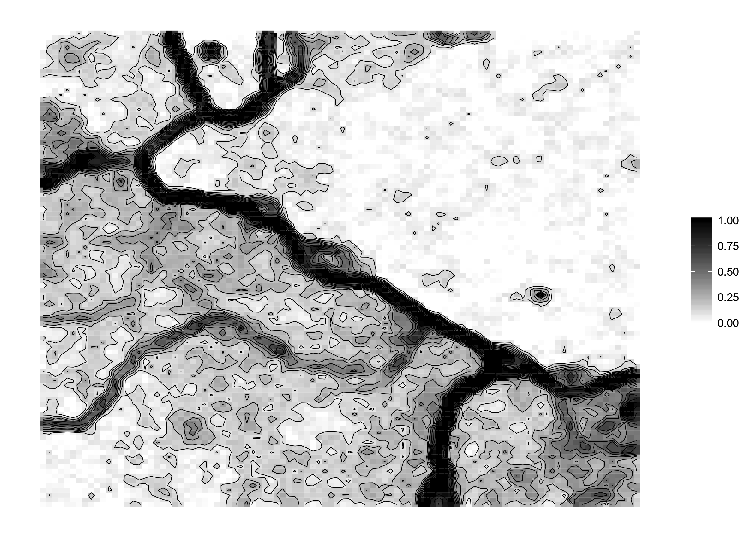
U-Matrix visualizations reveal dataset complexity in a manner much different than t-SNE
t-SNE map
10 x 10
(Flow-
SOM
default)
20 x 20
Data type: Mass cytometry
Dims: 42, surface markers
Cell type: PBMCs
Cells: 100,000
50 x 50
100 x 100

Slide 3
The majority of the SOM is populated with at least one cell
U-Matrix
Abundance
0-1 Thresholded Abundance
SOM size: 100 x 100
Data type: Mass cytometry
Dims: 42, surface markers
Cell type: PBMCs
Cells: 100,000

Slide 4
Marker expression patterns are concordant with the U-Matrix
U-matrix
CD14
CD16
CD3
CD4
CD8
CD11c
CD7
CD56
CD20

Slide 5
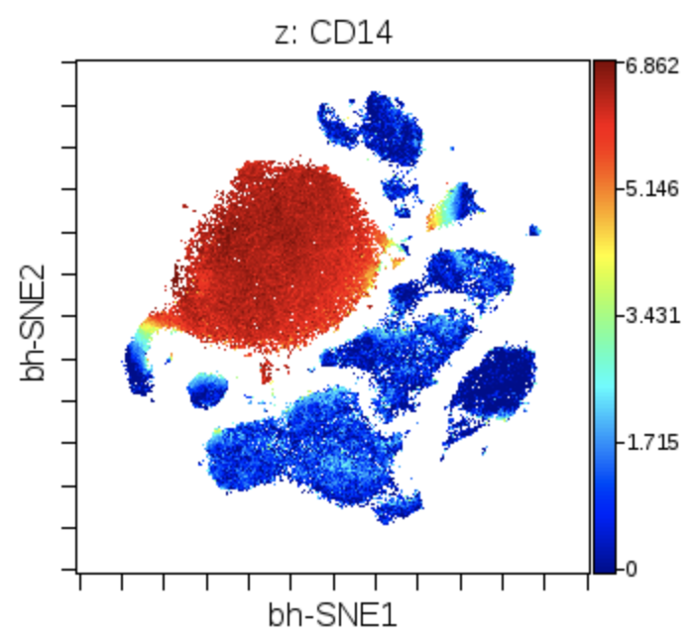
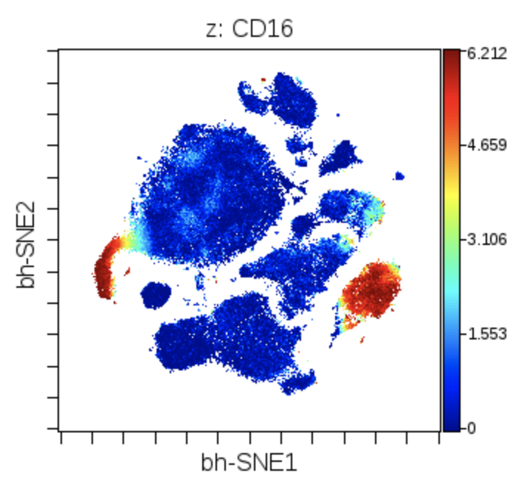
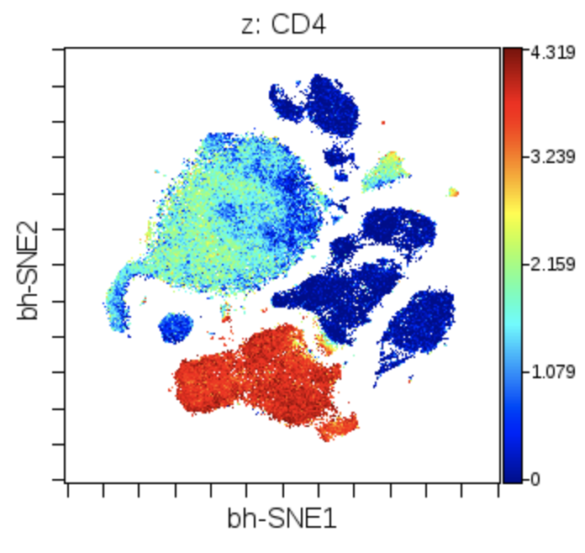
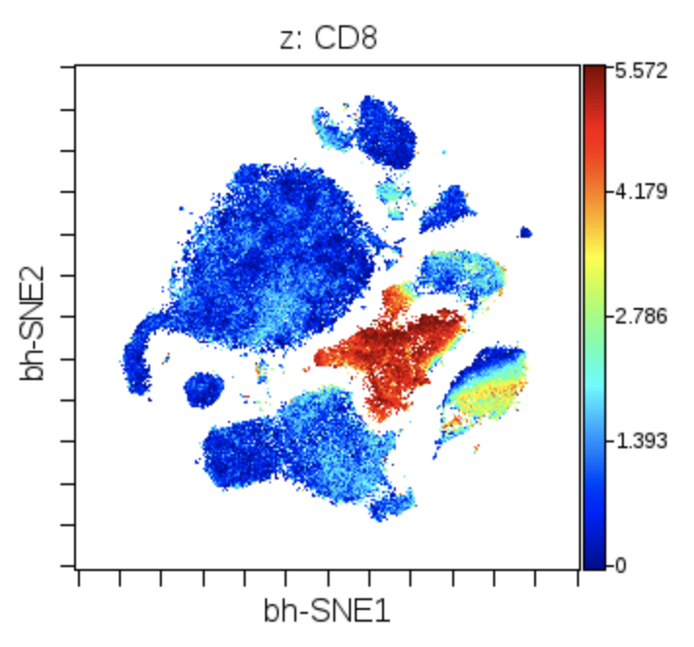
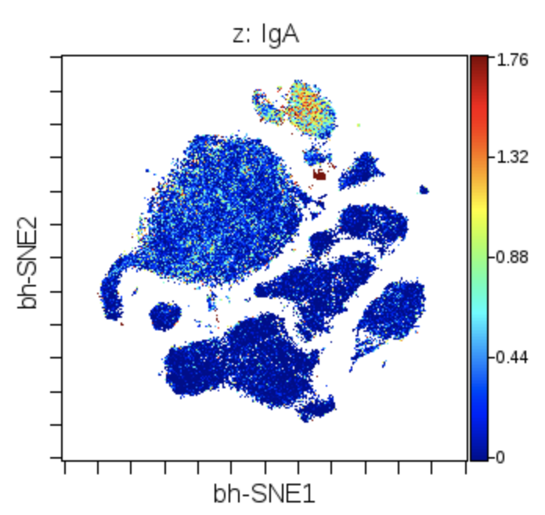
SOM vs t-SNE: colors of marker expression
CD14
CD16
CD4
CD8
IgA

Slide 6
U-matrix visualization with alternate distance and neighbor aggregation functions
Euclidean mean
Euclidean max
Chebyshev mean
Chebyshev max

Slide 7
Color of U-Matrix by identity of the meta-clusters
U-matrix
2 clusters
5 clusters
10 clusters
20 clusters
50 clusters
100 clusters
500 clusters

Slide 8
U-Matrix versus KNN-density estimation for SOM
U-matrix
k = 1
k = 10
k = 50
k = 100
k = 200
k = 500
k = 1000

Slide 9
U-matrix fidelity: detecting topology of the SOM
Similarity of Outer Moore Neighborhood vs
KNN with K of 8
U-matrix

Slide 10
U-matrix of SOM done on other datasets (eg. wanderlust)

Slide 11
Leave-one-out U matrix computation with max() and mean() of all matrices

Slide 12
Re-make U matrix with Chebyshev distance (max of the distances)

Slide 13
KNN with K of 8 compared to actual Moore neighborhood: color map by identity concordance hyp = folds exist

